Slide 1
FES study results

Slide 2
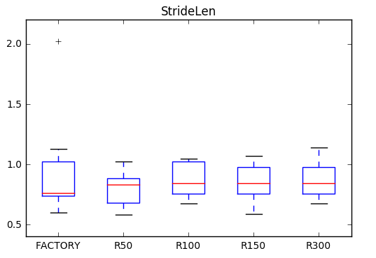
Stride length
R = rising ramp (factory default 200ms)

Slide 3
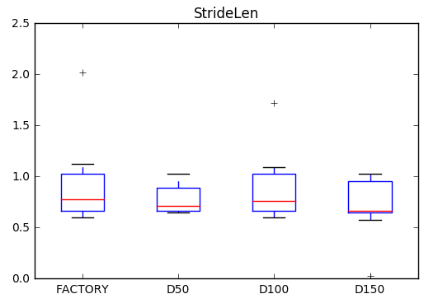
D = delay (factory default 0ms)

Slide 4
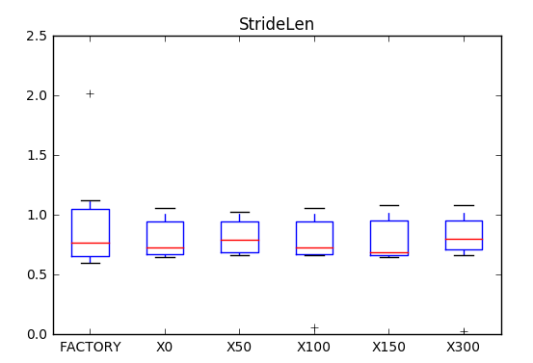
X = extension (factory default 200ms)

Slide 5
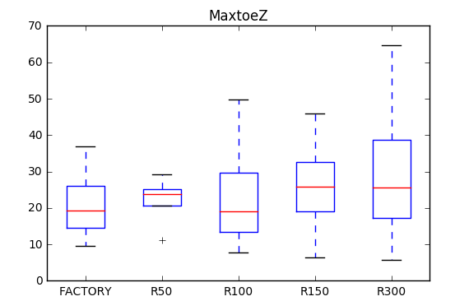
R = rising ramp (factory default 200ms)
Toe Clearance (max in swing)

Slide 6
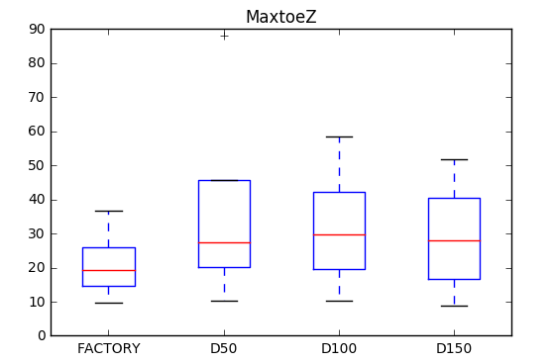
D = delay (factory default 0ms)

Slide 7
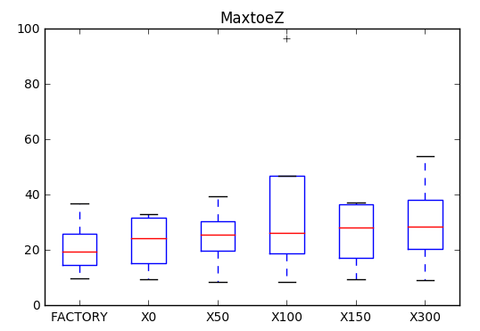
X = extension (factory default 200ms)

Slide 8
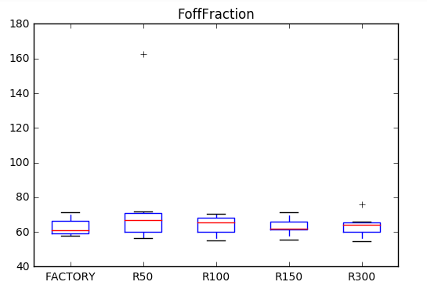
R = rising ramp (factory default 200ms)
Foot off %

Slide 9
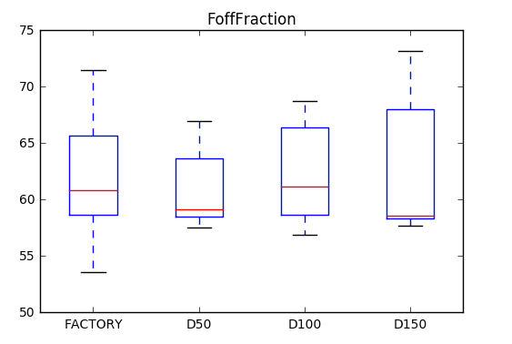
D = delay (factory default 0ms)

Slide 10
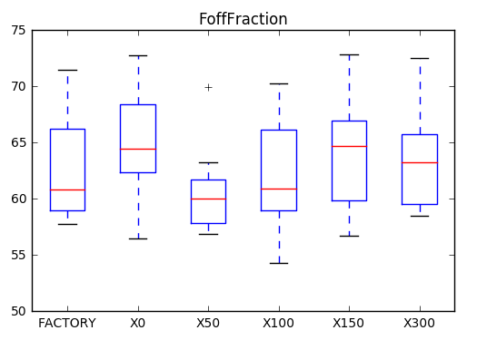
X = extension (factory default 200ms)

Slide 11
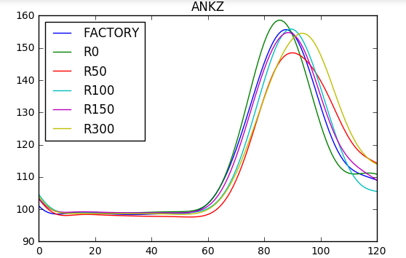
R = rising ramp (factory default 200ms)
Ankle dorsiflexion

Slide 12
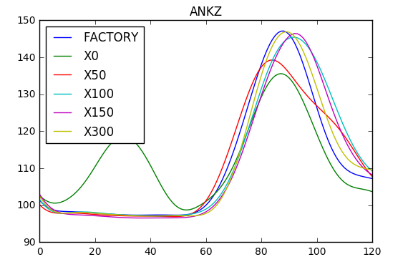
X = extension (factory default 200ms)

Slide 13
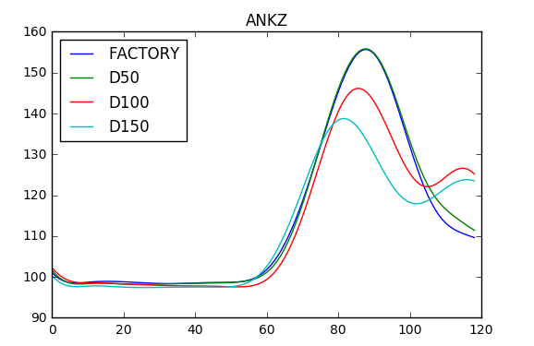
D = delay (factory default 0ms)

Slide 14
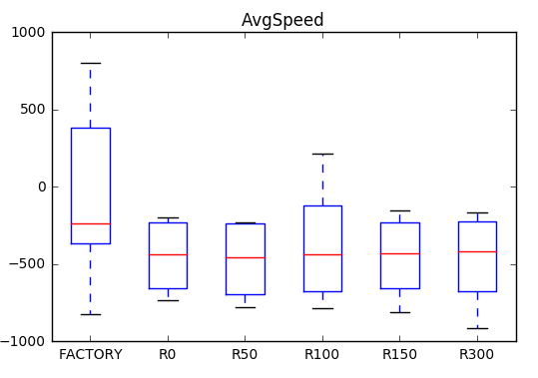
R = rising ramp (factory default 200ms)
Walking speed

Slide 15
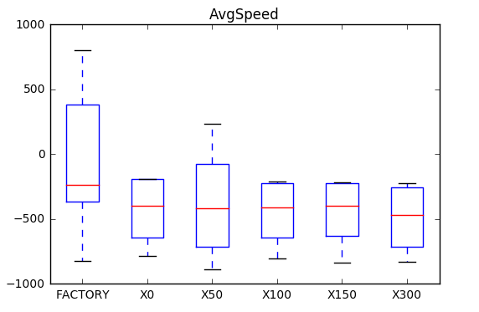
X = extension (factory default 200ms)

Slide 16
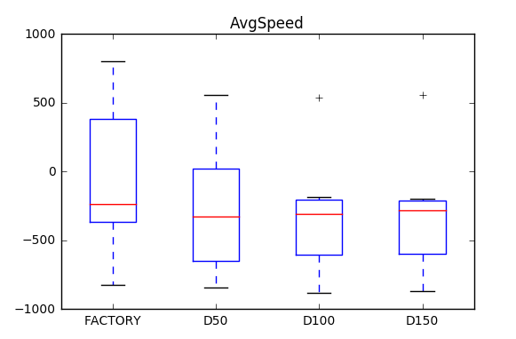
D = delay (factory default 0ms)

